Slide 1
INVESTIGATING RESPONSE-DRIVEN PROMPTING METHODS FOR LLM EFFICIENCY
A Systematic Literature Review
Author: Yashashwini Sidramappa Awate
Institution: Otto von Guericke University Magdeburg, Germany
Course: Recent Topics in Business Informatics
Wise 2025/2026
yashashwini.awate@st.ovgu.de
28 | 01 | 2026 - Student ID 256228

Slide 2
The Motivation: Why Efficiency Matters
RTBI - 28 | 01 | 2026 - Student ID 256228
Large Language Models deliver strong performance but are expensive to run [Wei et al., 2022] - ranging from $100,000 to $1,000,000+ annually for large organizations.
Inference cost increases with token usage and latency - such as Prompt Compression (45% token reduction) [Zhong et al., 2023] and Smart Routing (40-52% latency reduction) [Tan et al., 2024], are designed to target these exact metrics.
Energy consumption of LLMs raises sustainability concerns - each inference consumes 0.5–5 watt-hours of electricity, making efficiency an "environmental imperative" for organizations concerned with carbon emissions.
Efficient prompting offers a software-level solution without retraining models - Response-driven prompting provides a high-leverage, 'model-agnostic' optimization that reduces costs without the computational overhead of retraining or fine-tuning

Slide 3
RTBI - 28 | 01 | 2026 - Student ID 256228
The Problem Statement
The Economic Barrier: Production-scale LLM inference generates substantial operational costs, with annual expenses ranging from $100,000 to $1,000,000+ for large organizations.
The Environmental Challenge: Each LLM inference consumes 0.5–5 watt-hours of electricity, contributing significantly to data center carbon emissions.
The Trade-off Myth: Traditional optimizations (e.g., smaller models) often sacrifice 5–15% accuracy on complex tasks, creating a perceived conflict between efficiency and quality.
The Research Infrastructure Gap: 72% of existing studies fail to measure both efficiency and quality simultaneously, impeding the ability to find balanced solutions.
The Software-Level Opportunity: There is an urgent need to investigate response-driven prompting intelligent interaction design that reduces costs without requiring model retraining or architectural changes.

Slide 4
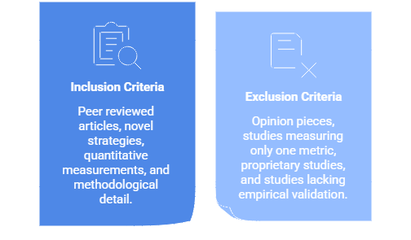
PRISMA-Compliant Systematic Review
RTBI - 28 | 01 | 2026 - Student ID 256228
METHODOLOGY
Search Period: January 1, 2022 – December 31, 2025
Databases: Google Scholar, arXiv, IEEE Xplore, ACM, Scopus
Stage 1 321 candidates | Stage 2 180 title/abstract | Stage 3 74 full-text | Stage 4 32 included ✓

Slide 5
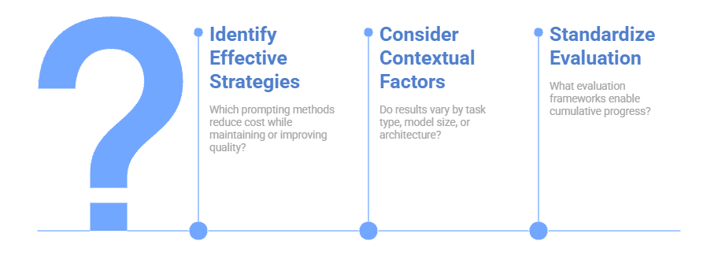
RTBI - 28 | 01 | 2026 - Student ID 256228
RTBI - 28 | 01 | 2026 - Student ID 256228
3 Research Questions Driving This Review

Slide 6
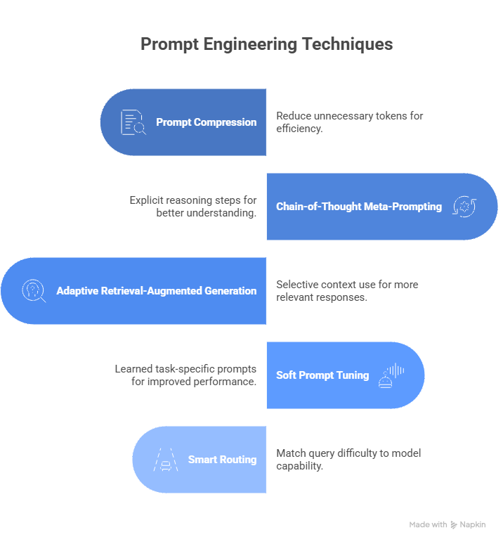
Response-Driven Prompting Strategies
RTBI - 28 | 01 | 2026 - Student ID 256228

Slide 7
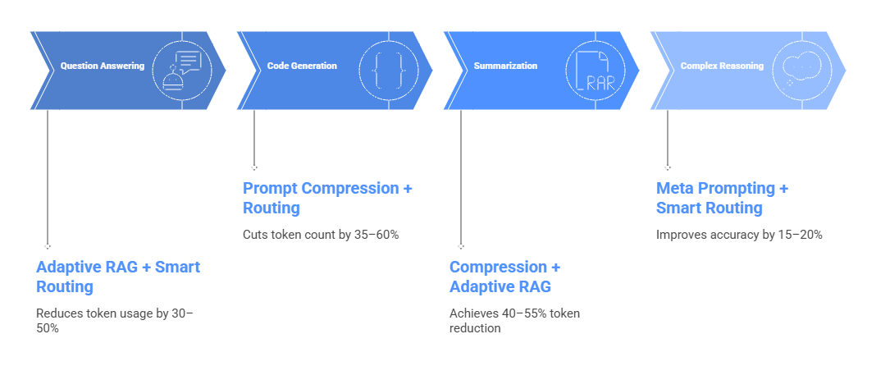
Strategic Recommendations by Task Type
RTBI - 28 | 01 | 2026 - Student ID 256228
The key insight is that no single strategy is universal, optimization must be task-specific.

Slide 8
RTBI - 28 | 01 | 2026 - Student ID 256228
THE CORE INSIGHT
Efficiency and Quality Are Not Opposing Forces
Conventional Wisdom:
Cheaper models → worse answers (trade-off)
Evidence Shows:
Intelligent prompting → better AND cheaper
Why?
Inefficiency = noise, confusion, wasted tokens
Efficiency = clear signal, focused context, smart routing
Impact:
Replicable, systematic, generalizable across 32 studies in the SLR

Slide 9
All 5 strategies prove: Efficiency ≠ Quality Loss
Conventional Wisdom:
Cheaper models → worse answers (5-15% accuracy loss assumed)
Evidence Shows:
Intelligent prompting → BETTER AND CHEAPER
• Compression: 45% tokens saved + 95-102% quality preserved
• Chain-of-Thought: +18% accuracy at -2% to +5% token cost
• Adaptive RAG: 35% tokens saved + 20-35% less hallucination
• Soft Tuning: 95% parameters reduced + 1-5% accuracy gain
• Smart Routing: 40% latency faster + 99.1-99.5% accuracy maintained

Slide 10
Implementation Roadmap
RTBI - 28 | 01 | 2026 - Student ID 256228
Phase 1: Assessment & Baseline (2 Weeks)
Audit current system metrics: token count, latency, API costs, and output quality.
Identify primary bottlenecks to select the most suitable strategy (e.g., Compression for high token volume).
Phase 2: Strategy Implementation (2 Weeks)
Compression: Integrate libraries like LLMLingua.
Routing: Train a difficulty classifier on 500–1,000 examples.
Phase 3: Validation & Tuning (2 Weeks)
Conduct A/B testing on 10,000+ queries to compare optimized vs. baseline performance.
Iterate on hyperparameters like compression aggressiveness or routing thresholds.
Phase 4: Production Deployment (1 Week)
Execute a gradual rollout (10% → 50% → 100%) while continuously monitoring metrics.
Total Timeline: A full implementation typically requires 6–7 weeks.

Slide 11
Practical Implications - Real-World Economic Impact
RTBI - 28 | 01 | 2026 - Student ID 256228
High ROI: Response-driven optimizations provide rapid cost reduction with payback periods as short as 2- 4 weeks.
Scenario 1: Customer Support Chatbot
By applying Compression + Routing, organizations can expect a 35% token reduction.
Scenario 2: Research Analysis System
Using Compression + Adaptive RAG on long documents can yield a 50% reduction in token costs.
Scale of Savings: Annual savings range from $8,000 for small systems to over $900,000 for large-scale deployments.

Slide 12
Key Research Gap
RTBI - 28 | 01 | 2026 - Student ID 256228
The Findings: Out of 321 candidate papers, 72% (232 papers) were excluded because they measured only efficiency or only quality.
Infrastructure Problem: This "measurement gap" makes it nearly impossible for practitioners to understand the true trade-offs of an optimization strategy.
Metric Coverage Breakdown:
Token Counting: 28/32 papers 88% of studies (High adoption).
Latency Measurement: 18/32 papers 56% of studies (Moderate adoption).
API Cost Tracking: 12/32 papers 38% of studies (Low adoption).
Energy Consumption: 5/32 papers Only 16% of studies (Critical neglect).
The Quality Bias: While 100% of included studies track task accuracy, only 25% measure hallucinations, which is a vital metric for production-safe efficiency.

Slide 13
Conclusion
RTBI - 28 | 01 | 2026 - Student ID 256228
RTBI - 28 | 01 | 2026 - Student ID 256228
Five response-driven strategies consistently reduce LLM costs, Smart interaction design is more scalable than larger models.
Efficiency vs. Quality: The evidence proves these are not opposing forces; thoughtful interaction design supports both simultaneously.
Key Challenge: The primary hurdle in modern AI is often not model capability, but how these systems are deployed efficiently.
Standardization: Bridging the 72% measurement gap through balanced evaluation is essential for the field's maturity.
Moving Forward: Future research must prioritize automated strategy selection and energy-centric optimization to ensure sustainable AI growth.

Slide 14
Future Research Directions
RTBI - 28 | 01 | 2026 - Student ID 256228
RTBI - 28 | 01 | 2026 - Student ID 256228
Automated Strategy Selection: Build AI systems that automatically recommend which strategy (compression vs. routing vs. RAG) works best for each specific task.
Explainable Efficiency: When compression removes tokens, which information was lost and why? Make efficiency gains interpretable.
Cross Model Generalization: Do strategies trained on GPT 4 transfer to Llama? Or Claude? Study generalization across model families.
Energy First Optimization Framework: Instead of minimizing tokens, directly minimize energy consumption. Different approach, different optimizations.
Specialized Domain Studies: Develop task specific efficiency strategies for critical domains (medical diagnosis, legal analysis, financial decisions) where quality cannot be compromised.

Slide 15
Thankyou, Any questions ?
RTBI - 28 | 01 | 2026 - Student ID 256228

